Slide 1
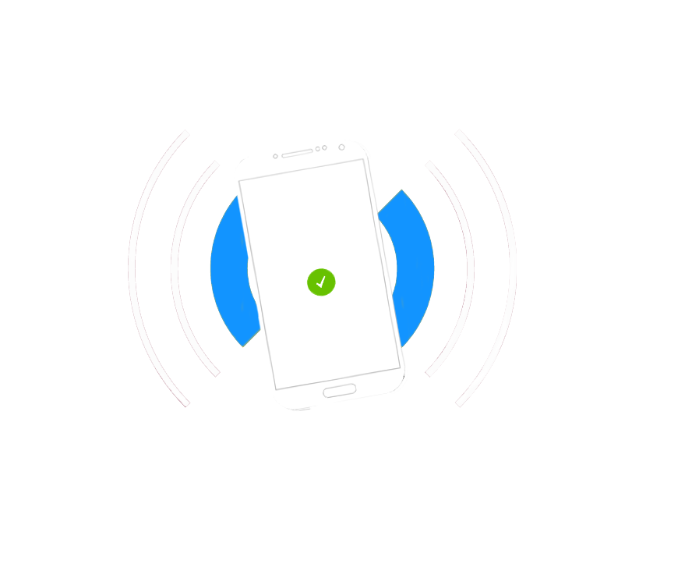
Prototype
App Name : TurnUp
Group Number : 27
Group Tutor : Simon Taylor
Group Members
Loredana Vadana
Shreyas Jain
Maedin Zekarias
Taqi Tazwar
Thomas Hunt
Mark Andrews
TurnUp

Slide 2
Contents
Software development process
HCI Model
How it works?
Pros & Cons
Exchange of information
NFC
Use cases
Flowcharts
Prototype
Database

Slide 3
Software development Process
Focus on customer needs.
Involve customer in the development process.
Frequent updates of the design.
SCRUM approach
Establish our project objectives: developing an attendance app that uses NFC technology
We rely on self-organizing skills, we help each other to perform at the highest level.
We progress through sprint cycles:
Decide on what we can work and create a “to do” list;
Test and integrate into the product;
Attend short meetings to discuss progress and identify issues;
Conduct a review and demonstrate our work to the tutor.

Slide 4
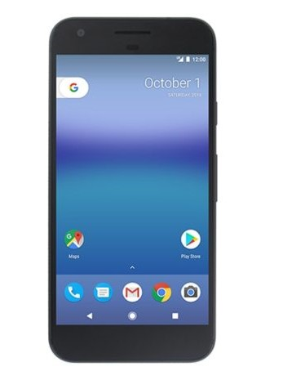

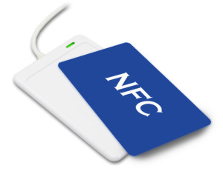
HCI Model
Lecture Information
Sends Information
For History Screen
NFC Tag
Tap Phone
Sends Information
to server
Server
User’s Phone

Slide 5
How it works?
User and Lecturer can register using their ID details.
Manually input the timetable into our application.
NFC Chip for Each Lecture, containing the lecture Information.
User Taps the phone to get the lecture details.
The app sends the details to the server to register user.
Server sends back the history to display on history page.
Server sends registration details to lecturer.

Slide 6
Pros & Cons
Pros :
No need of student ID to register.
Convenient for lecturer to manage attendance.
No need of tablet to manage the attendance.
Cons :
Need NFC for every Lecture, or changing details every time on the chip.
Only on Android (For now).

Slide 7
Exchange of Information
NFC to Phone
Lecture Name, Date & Time of the Lecture, Lecturer Name.
Phone to Server
NFC Details, Student name, Student ID, Date & Time of attendance.
Server to User
History of attendance
Server to Lecturer
Attended student’s ID, Student Name, Date & Time, NFC Details.

Slide 8
NFC - Near Field Communication
close range wireless communication between devices
sends information through radio waves
helps exchange information by tapping / waving
involves one transmitting device and another device to receive the signal
newer version of RFID
unlike RFID it only works on a very close range
consumes little power since the transmission is short range
used for payments, data transfers, bookings, opening doors, obtaining data, turn on devices, etc.
the NFC tags can be coded in order to change the settings on these devices
has three distinct modes:
peer-to-peer (allows two devices to exchange information)
read/write (one-way data exchange, one device links to another in order to read information from it, uses NFC tags)
card emulation (NFC device can be used as a contactless bank card or to make payments)

Slide 9


Use Cases
Creates Account
Creates Account
Check timetable
Get alerts for upcoming classes
Can Check Student Attendance
Can Register Using Phone
STUDENT
Can Export Attendance as Excel File
LECTURER
Can Check Attendance History

Slide 10
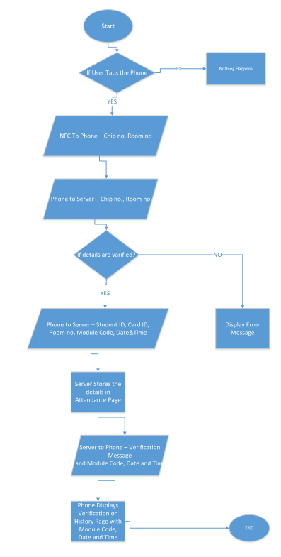
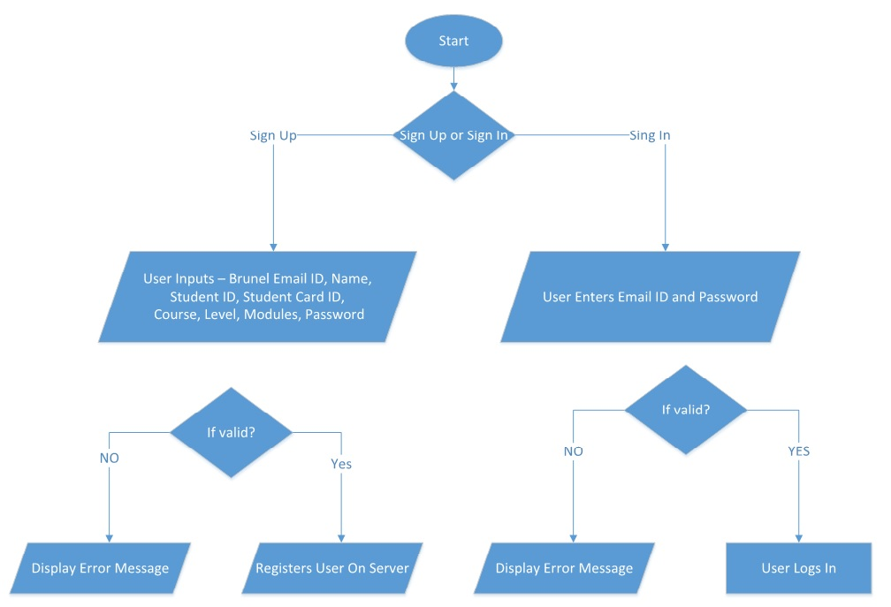
Flowcharts
Main
Flowchart
Sign Up / Sign In
Flowchart

Slide 11
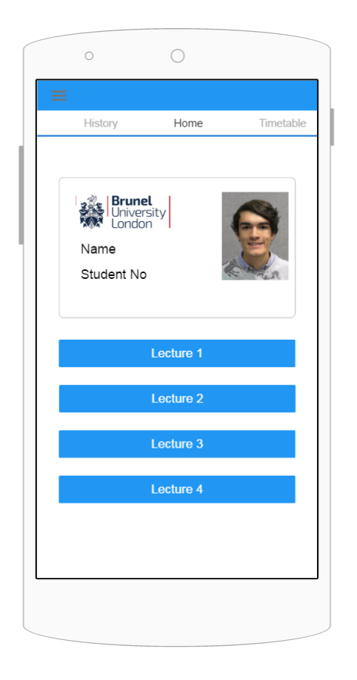
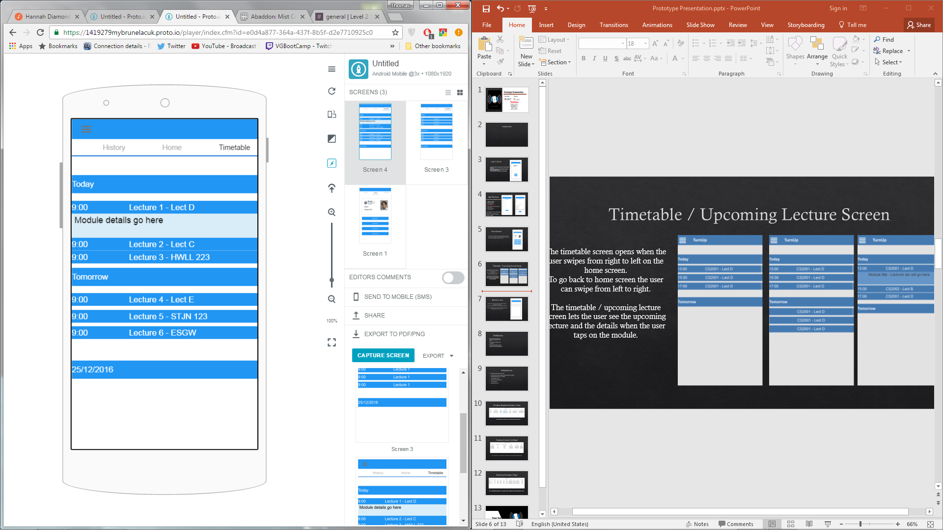

Functionality
Upcoming Lecture
Screen
Main Screen
Swipe left

Slide 12
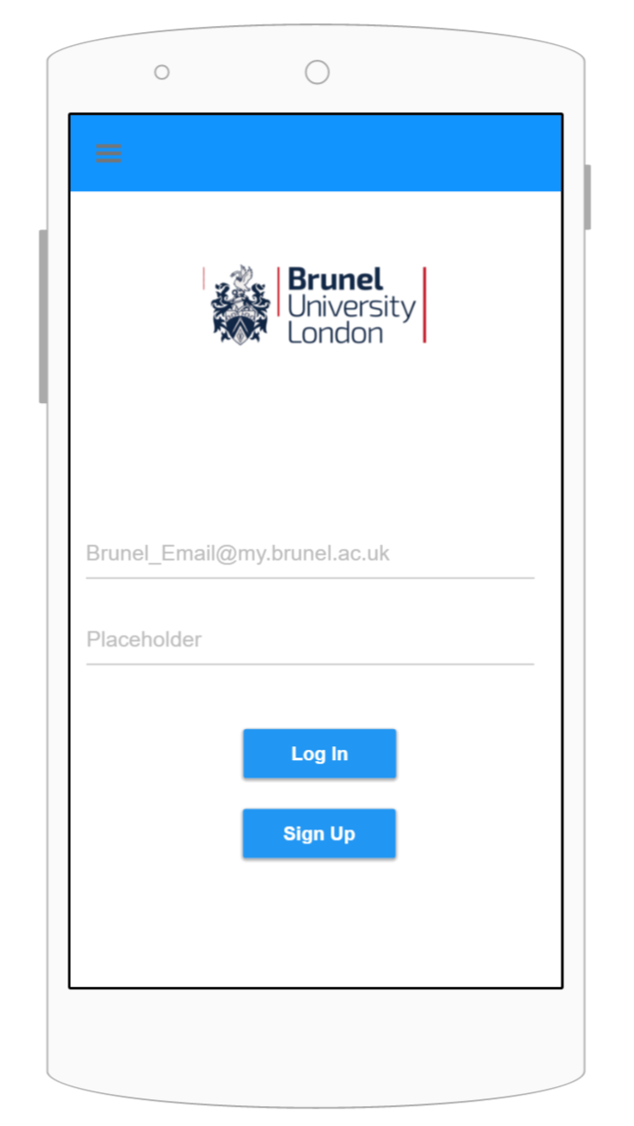
Log In Screen
The user must enter their Brunel Email ID and password
to log into their account.
Log In button logs user in the application, which takes
the user to the home screen.
Sign Up button will take the user to sign up screen.

Slide 13
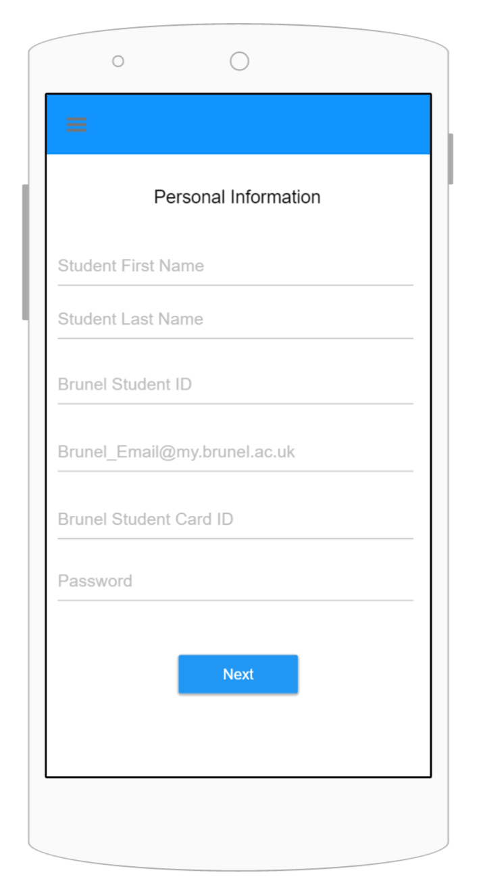
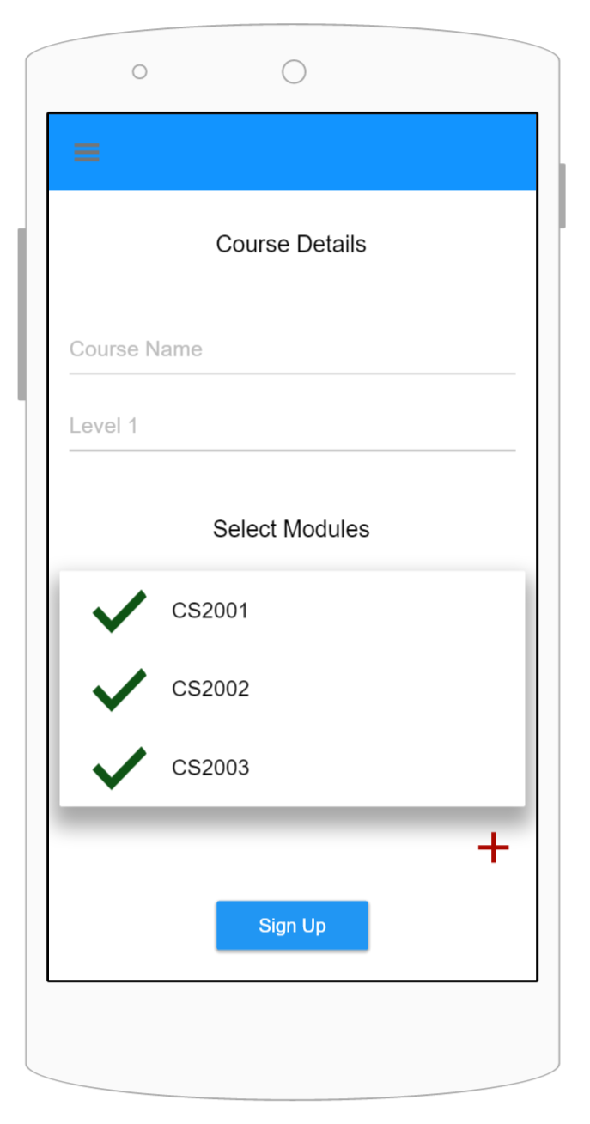
Sign Up Screen
User needs to enter the following to sign up:
Student First Name
Student Last Name
Brunel Student ID No.
Brunel Email ID
Password and password confirmation
Course Name
Level of the Course
Module Codes
Next button will take the user to second page. Sign Up button will register the user account and take the user to Log In screen.
The user will be sent a verification email to activate their account.

Slide 14
Home Screen
The home screen provides a summary of upcoming lectures.
The user can swipe from right to left to go to time table screen
and left to right to access the history screen.

Slide 15
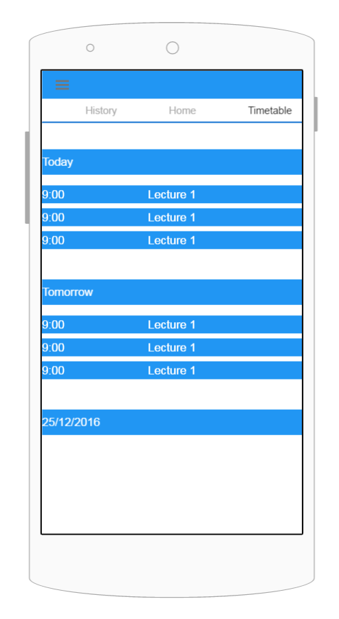
Timetable / Upcoming Lecture Screen
The timetable screen opens when the user swipes from right to left on the home screen.
To go back to home screen the user can swipe from left to right.
The timetable / upcoming lecture screen lets the user see the upcoming lecture and the details when the user taps on the module.

Slide 16
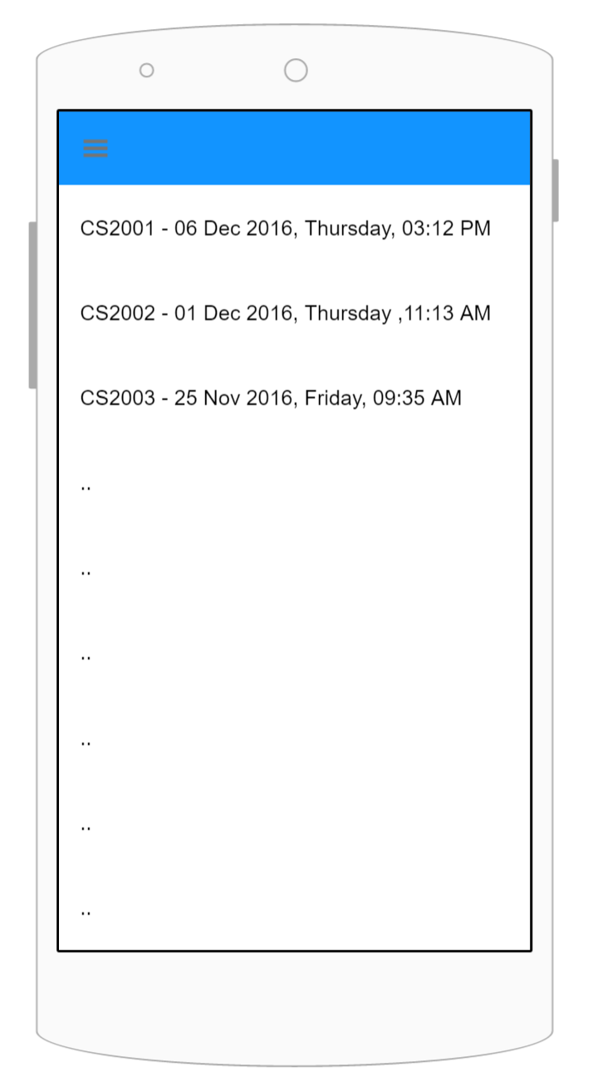
History Screen
The user can swipe from left to right on the home screen to
get to the history screen.
To go back to home screen, user can swipe from right to left.
History screen shows all the lectures student attended with
module code, date, day and time.

Slide 17
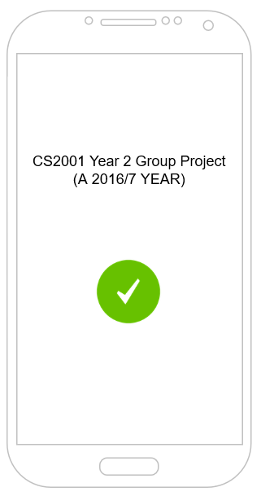
Notifications
When a lecture is attended, a notification is displayed on the screen.
The notification contains your module title.
The user can disable the popup notification via the settings screen.

Slide 18
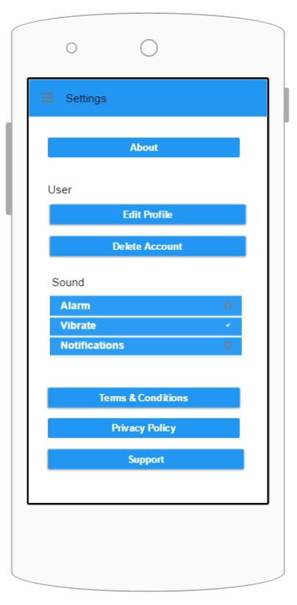
Settings Screen
Allows user to edit his profile.
Access information about the app.
Turns on / off the Alarm, Vibrate, Notifications functions.
User is able to delete his account.
By pressing this button, he will have the choice of confirming / cancelling this action.
Informs user about the app’s terms and conditions.
Informs user about the app’s privacy policy.
Allows user to contact our support team.

Slide 19
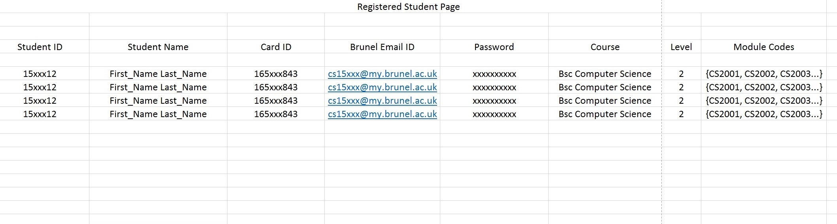
Database (Registered Student Page)
All the student details are stored in this server page after the user registers.

Slide 20
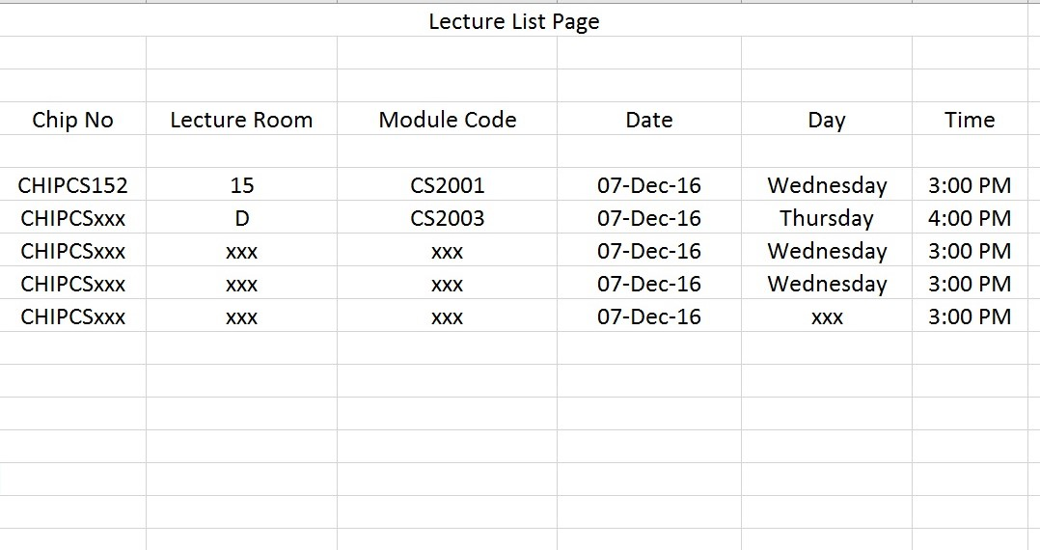
Database (Lecture List Page)
All the lecture details are stored on this page to verify the lecture when the student registers.

Slide 21
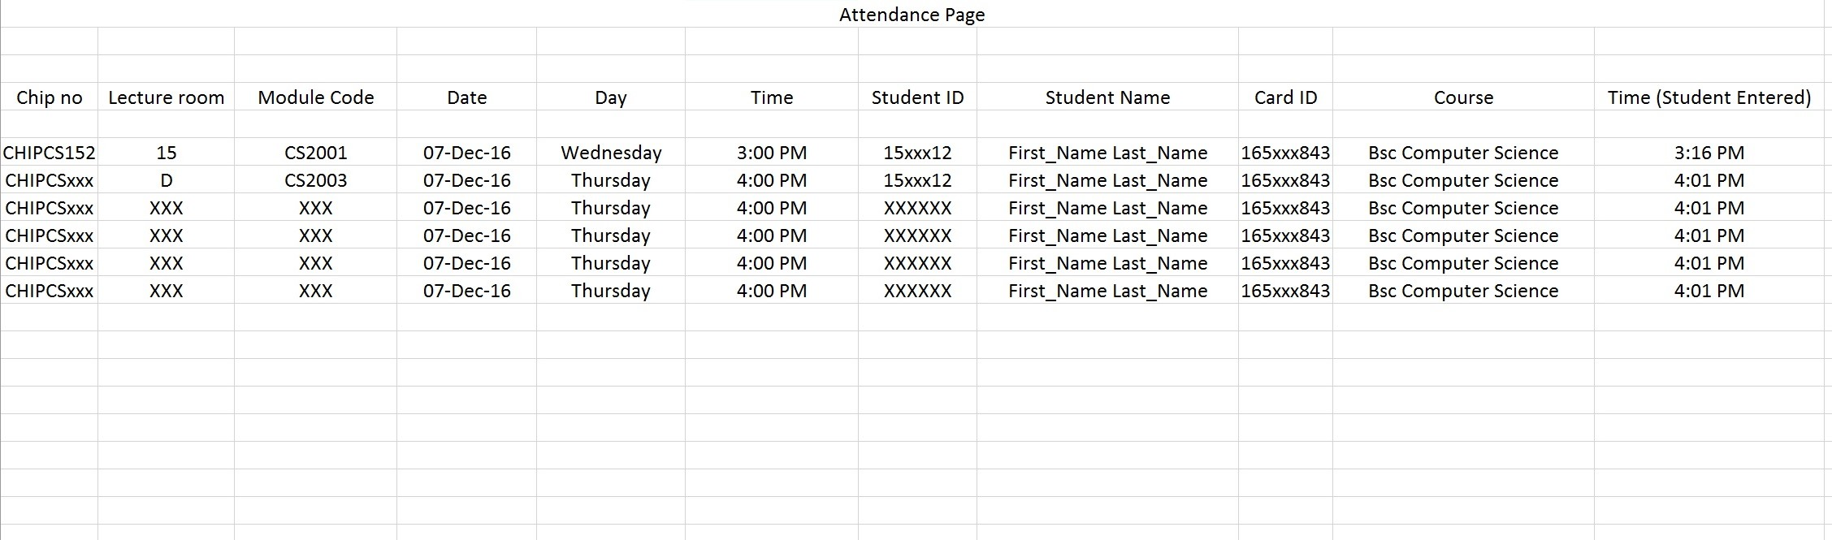
Database (Attendance Page)
This is the attendance page where all the attended students information and lecture information is stored.

Slide 22
Thank You!
TurnUp

